Slide 1




STAR COLLEGE SCHEME –
FUNDED BY DEPARTMENT OF BIO TECHNOLOGY (GOI)
ADVISORY COMMITTEE MEETING – 09.08.2023
PANDIT JAWAHARLAL NEHRU COLLEGE OF AGRICULTURE AND RESEARCH INSTITUTE
(A Government of Puducherry Institution affiliated to Pondicherry University, Puducherry and accredited to ICAR)
Serumavilangai, Nedungadu (PO),
KARAIKAL 609 603 - UT of Puducherry

Slide 2
SCHEDULE
Welcome
Chairman’s address
Introduction and address by the DBT Representatives
Introduction and address by the External Members
Briefing by the scheme coordinator
Presentation by the Department Coordinators
Video presentation
Interaction
Conclusion

Slide 3
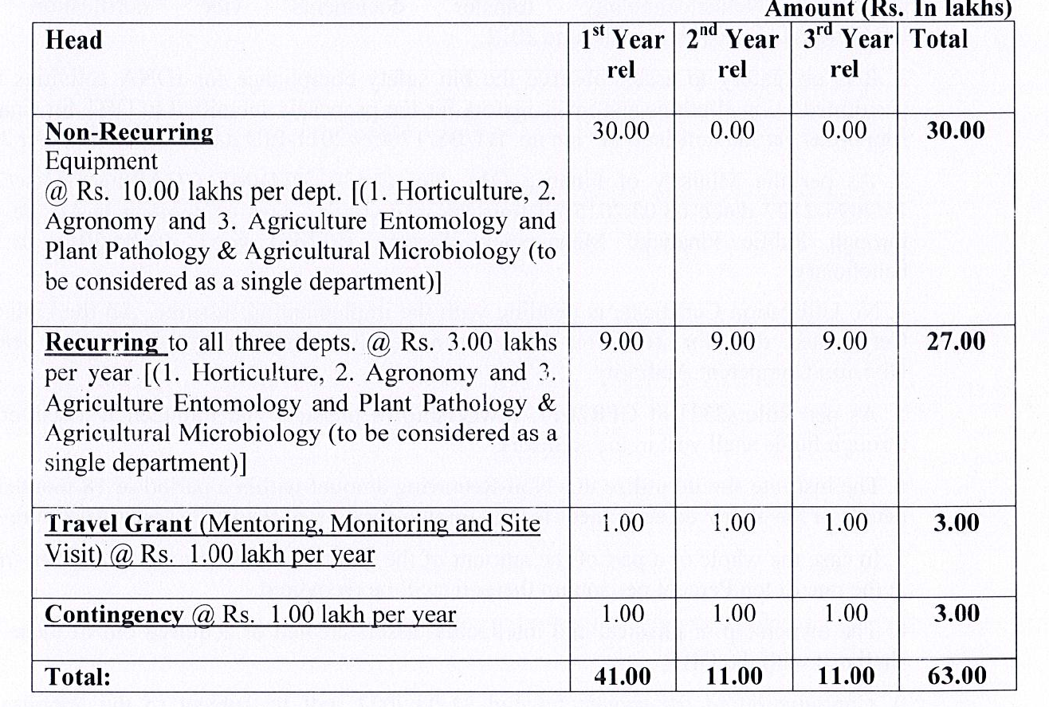
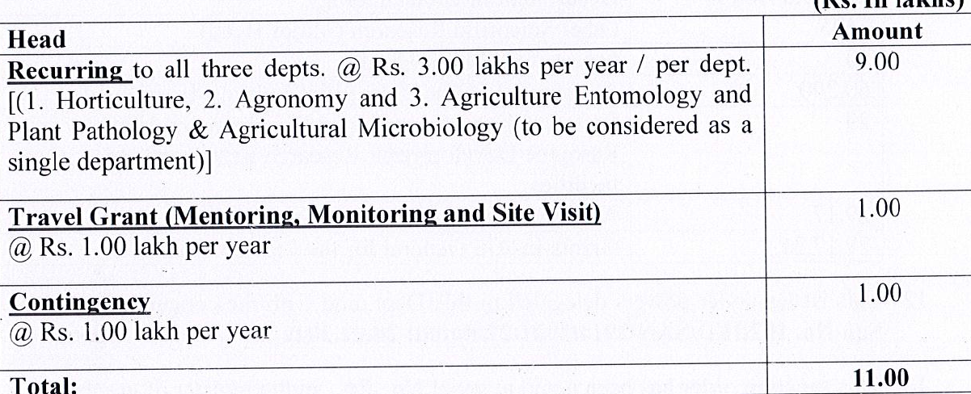
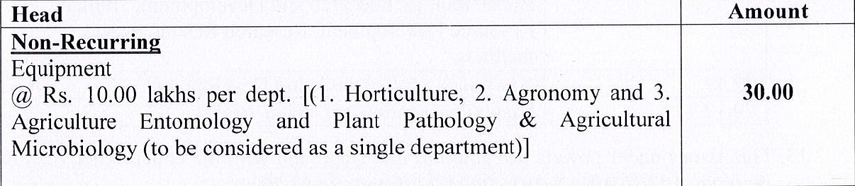







Slide 4
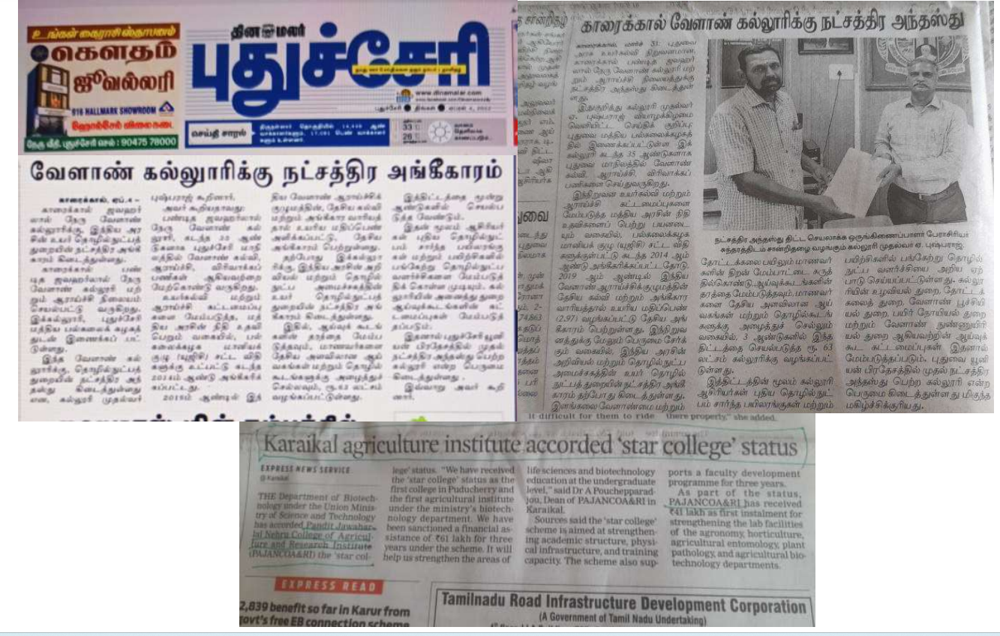

Slide 5
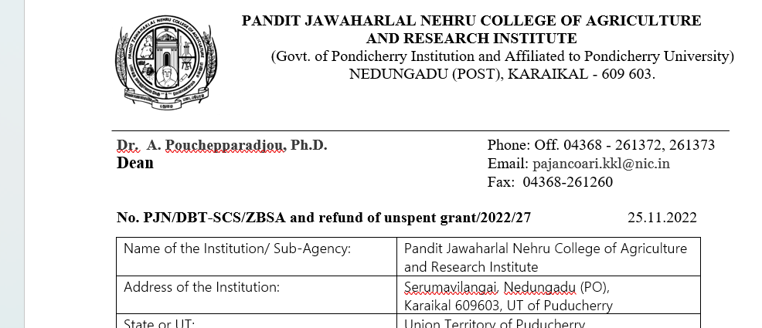
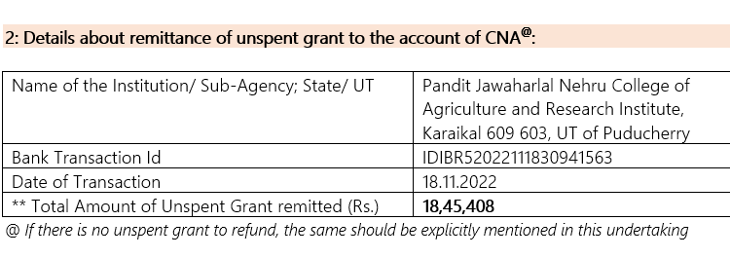

Slide 6
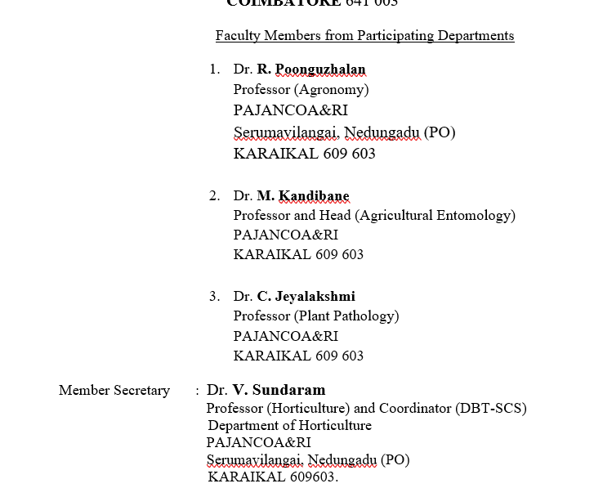
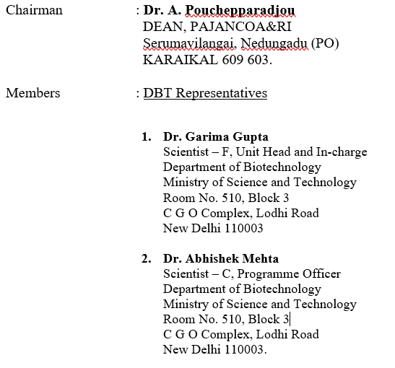
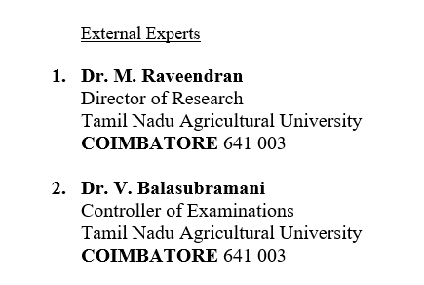
ADVISORY COMMITTEE CONSTITUTION
External Members

Slide 7
Non Recurring - 30,00,000
Recurring - 9,00,000
Contingencies - 1,00,000
Travel Grant - 1,00,000
Total - 41,00,000

Slide 8
Grant Received (Rs.) Expenditure till Expenditure
31.03.2023 as on 09.08.2023
Non Recurring - 30,00,000 26,87,634 29,88,831
Recurring - 9,00,000 8,51,741
9,98,999
Contingencies - 1,00,000 97,991
Travel Grant - 1,00,000 -
Total - 41,00,000 36,37,366 39,87,830
Balance amount (as on 09.08.2023) - Rs. 1,12,170*
* Rs. 1,00,000 - Travel Grant
Rs. 11,169 - Non Recurring
Rs. 1,001 - Recurring

Slide 9
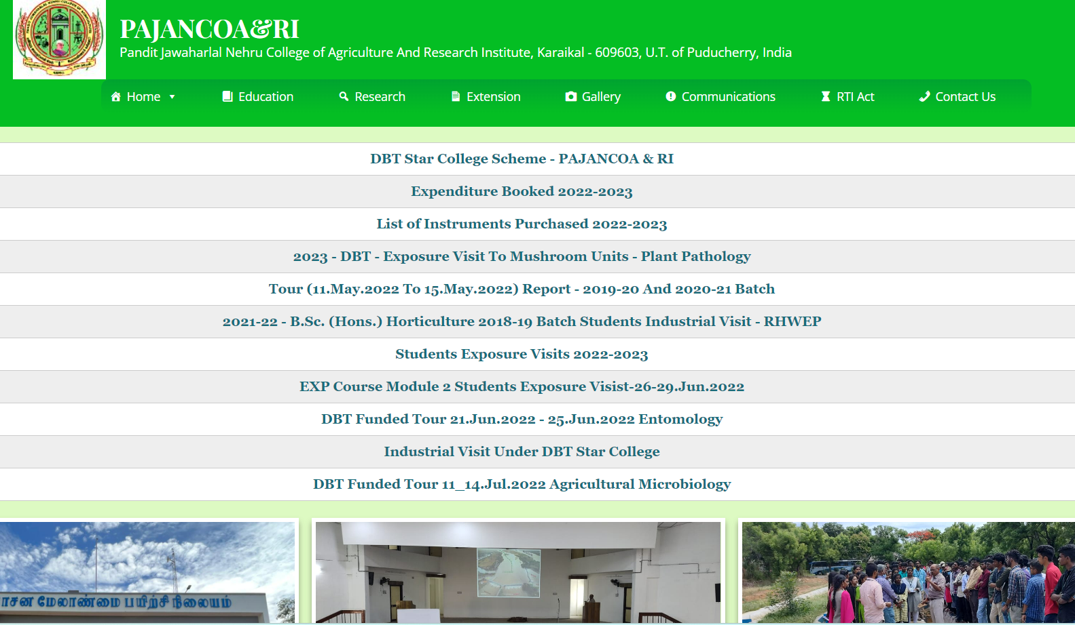
https://pajancoa.ac.in/wordpress/index.php/dbt-star-college-pajancoa/

Slide 10
FACULTHY STRENGTH OF SUPPORTING DEPARTMENTS
Sl. No. | Name of Department | Courses (B.Sc./M.Sc./PG Diploma, certificate etc.) offered | Regular Faculty members Total = 19
 |  |  | With Ph.D. | Without Ph.D.
01 | Agronomy | B.Sc. (Hons.) Agriculture B.Sc. (Hons.) Horticulture M.Sc. (Agri.) Agronomy | 08 | -
02 | Horticulture | B.Sc. (Hons.) Agriculture B.Sc. (Hons.) Horticulture M.Sc. (Hort.) Vegetable Science | 05 | -
03 | Agricultural Entomology | B.Sc. (Hons.) Agriculture B.Sc. (Hons.) Horticulture M.Sc. (Agri.) Entomology | 02 | -
04 | Agricultural Microbiology | B.Sc. (Hons.) Agriculture B.Sc. (Hons.) Horticulture | 01 | -
05 | Plant Pathology | B.Sc. (Hons.) Agriculture B.Sc. (Hons.) Horticulture | 03 | -

Slide 11
QUALITATIVE IMPROVEMENTS
Standardisation of rooting in cuttings of guava as well as ornamentals by the students of IV B.Sc. (Hons.) Horticulture of 2018-19 batch under the Experiential Learning Programme
The Post Harvest Laboratory of the Department of Horticulture is now well equipped giving opportunities for the students to get hands on experience in packaging, value addition and shelf life enhancement of perishables.
Twenty-eight students undergone the Experiential learning programme during 2022- 2023 had equipped themselves in all aspects of oyster mushroom cultivation and produced mushroom spawn through the infrastructure facilities created with SCS funding.
The undergraduate students of 2019- 2020 batch had the rare opportunity to visit commercial button mushroom cultivation unit and taken hands on training on button mushroom compost preparation and cropping with the scheme funding
Capturing the symptoms of diseases directly in the infected plant using hand held digital microscope gives throughput understanding about plant diseases to the students

Slide 12
Instruments purchased under the scheme were utilized by the students for isolation of 86 Rhizobium, 26 Azospirillum, 42 Azotobacter, 34 PSB and 21 Methylobacterium strains and they are under screening process for plant promoting traits like IAA, siderophore production, compatibility etc.,
Italian honeybee boxes and beekeeping accessories were not available earlier and its purchase has made the skill learning of students on apiculture and commercial beekeeping.
stereo zoom binocular microscope is helpful to visualize minute insects under higher magnification to study various micro-morphological characters of insect pest, parasitoids and predators

Slide 13
EDUCATIONAL TOUR OF STUDENTS (AGRICULTURE / HORTICULTRE)
Irrigation Management Training Institute, Thuvakudi, Tiruchirappalli, Tamil Nadu
Vallanadu Sustainable Agriculture Producer Company Limited, Sirkazhi
Semio-chemical laboratory of GPS Institute of Agriculture & Management, Peenya, Bengaluru
Department of Remote Sensing and GIS, TNAU, Coimbatore, Soil Testing Laboratory, Coimbatore (TN) and Indian Institute of Soil and Water Conservation, Ooty, Nilgiris (TN)
Gamma Ray Chamber Facility available at IIHR, Bengaluru
Annapoorna Organic Manure Production Unit, Karikalpalayam farm, Bengaluru
Multiplex Drones Pvt. Ltd., Vijaya Nagar, Bengaluru
Indo American Hybrid Seeds Private Ltd, Bengaluru

Slide 14
Silk worm Grainage centre, Trichy, Tamil Nadu
Mulberry nursery production center, Manigandam (Trichy), Tamil Nadu
Govermment Cocoon market, Coimbatore, Tamil Nadu
Silk reeling unit, Silk winding unit, Silk bleaching & dyeing unit, Coimbatore, Tamil Nadu
Silk weaving unit Gandhipuram Sarvodya Sangh, Coimbatore
Sericulture Department, FC & RI, TNAU, Mettupalayam

Slide 15
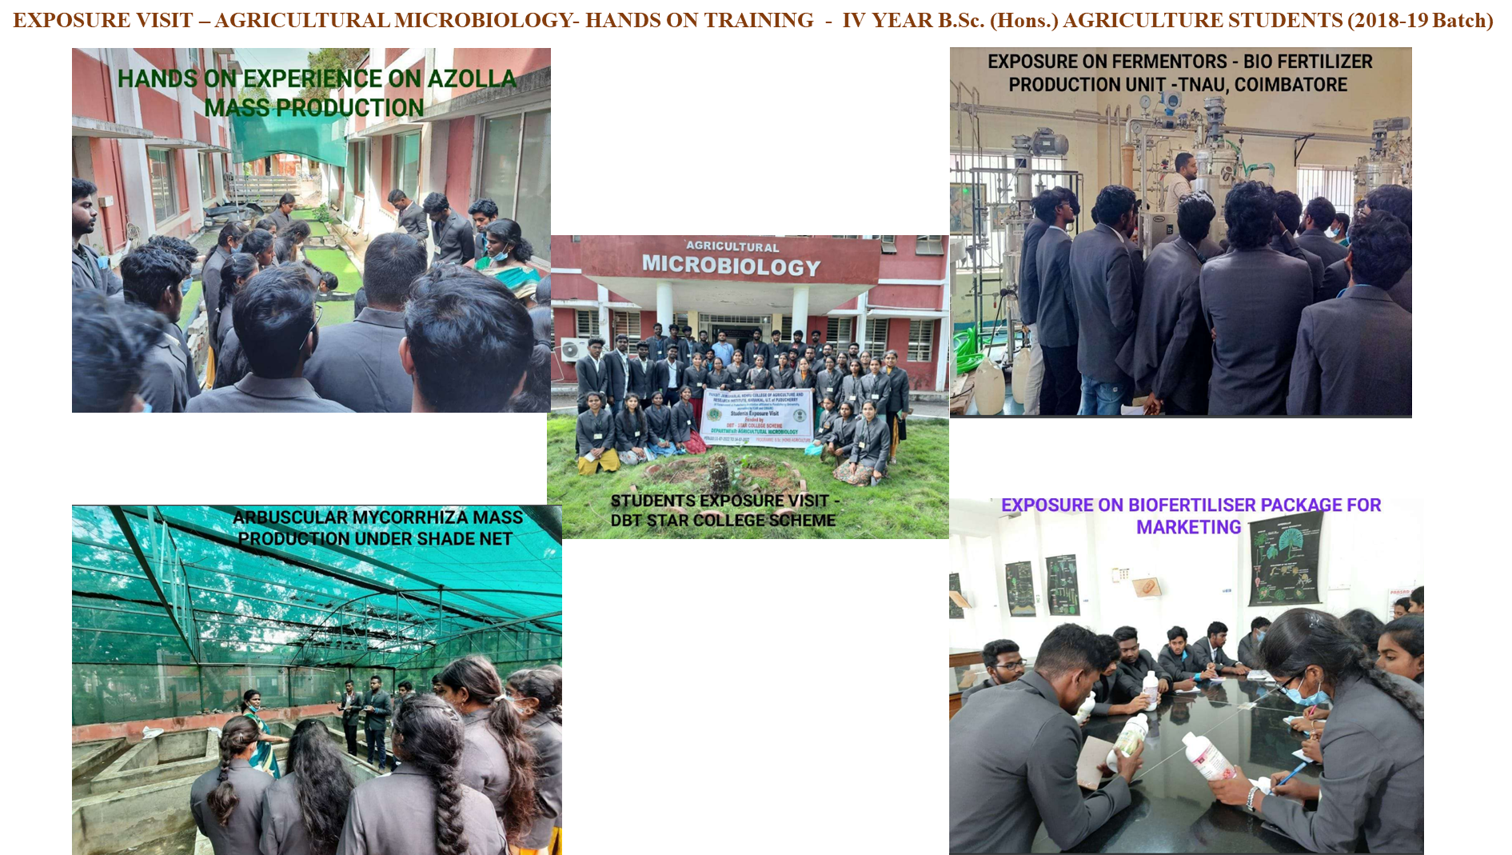
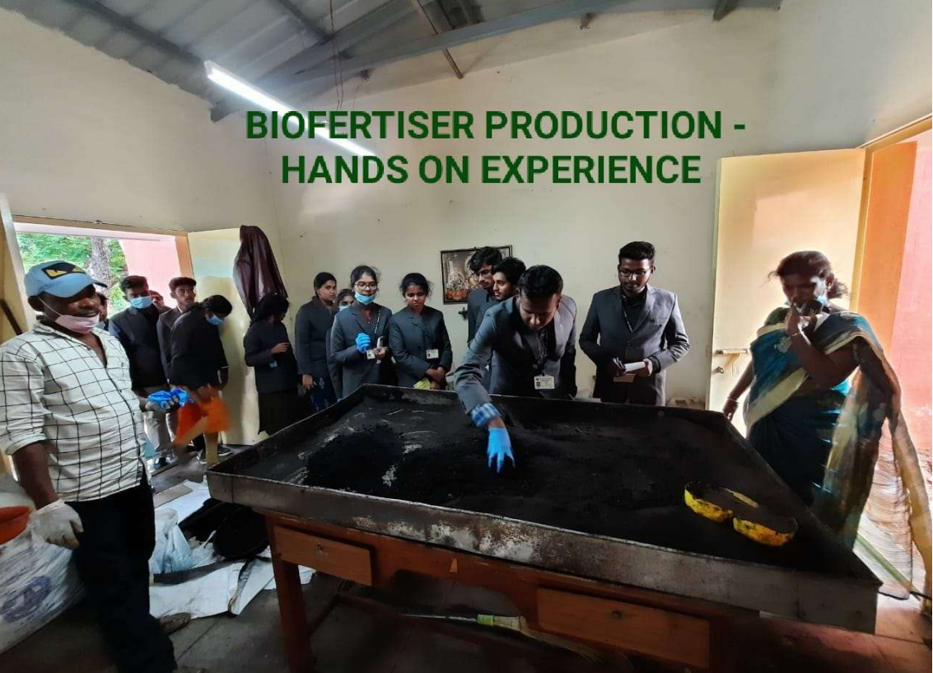
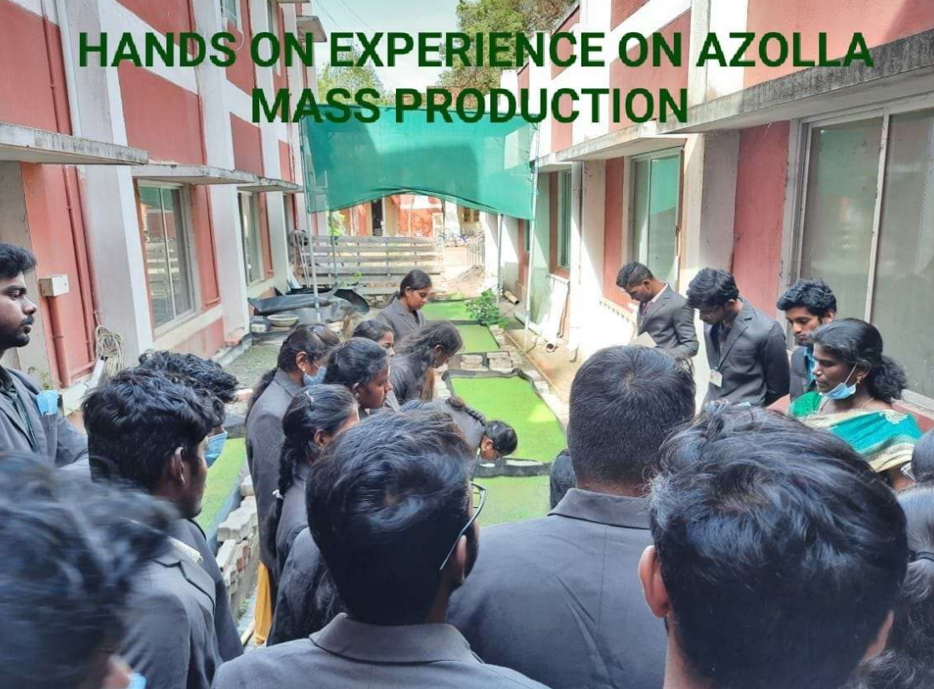
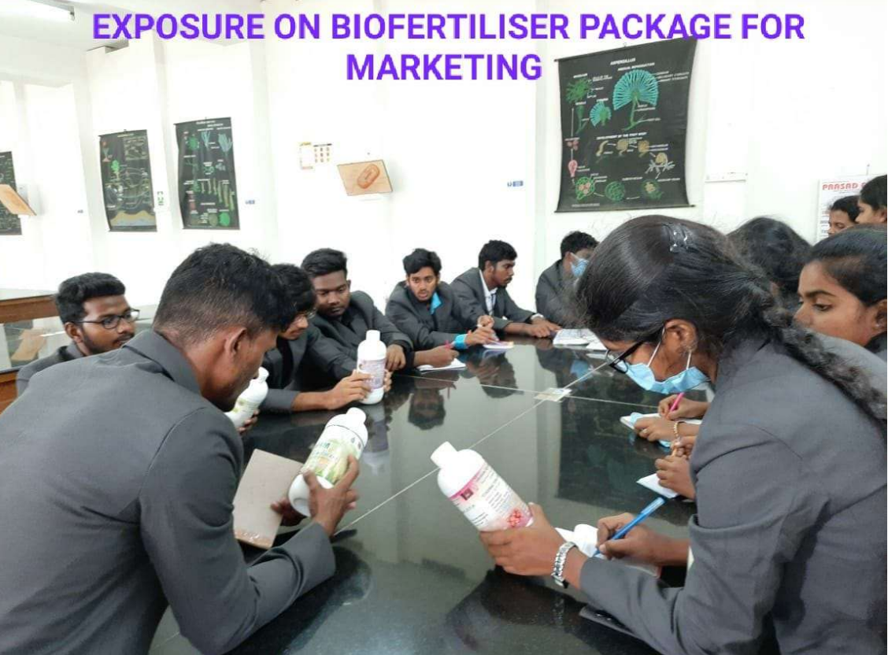
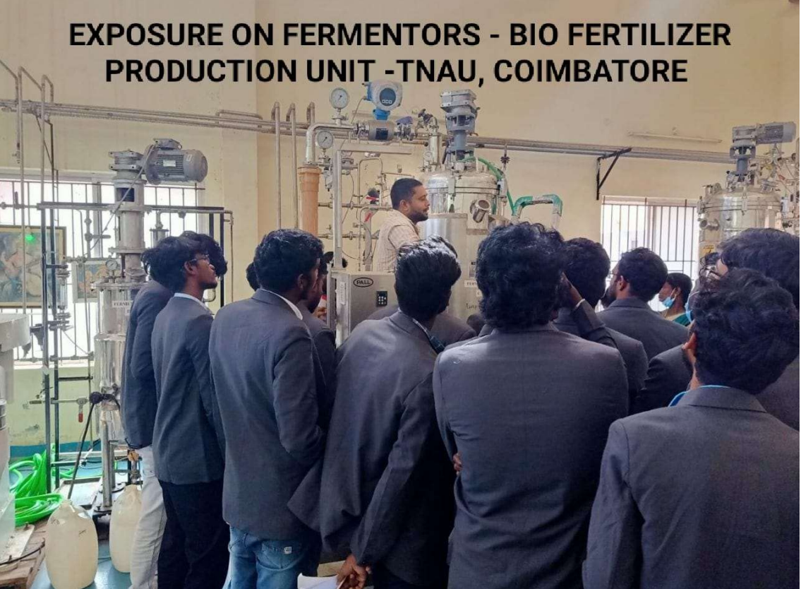

Slide 16
